Slide 1

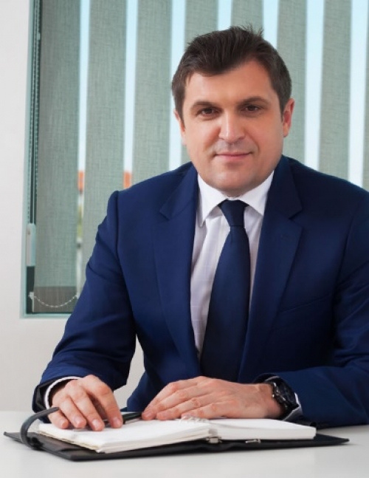

PROJECT MANAGEMENT PLATFORM (PMP) & PPP
BY:
DANIEL DOBREV

Slide 2




A PROJECT WITHOUT PLANNING IS ONLY A TASK; A PROJECT WITH PLANNING BECOMES A TRANSFORMATION.”

Slide 3
THE PROJECT MANAGEMENT PLATFORM (PMP) IS PRESENTED BOTH AS A PRACTICAL SET OF METHODS AND AS A LIFE PHILOSOPHY. PMP GIVES US A BLUEPRINT TO CONVERT IDEAS INTO SYSTEMS THAT HAVE OBJECTIVES, TIMEFRAMES AND ASSIGNED RESOURCES. WHEN WE ADOPT PMP WE LEARN TO MANAGE UNCERTAINTY, TO DESIGN INTERMEDIATE STEPS AND TO MEASURE OUTCOMES — NOT ONLY FOR BUSINESS PROJECTS BUT ALSO FOR PERSONAL GOALS. THE LECTURE WILL USE PMP TO LINK INDIVIDUAL ACTION AND SOCIAL IMPACT: PROJECTS BECOME A TOOL THROUGH WHICH A PERSON BECOMES AN INDEPENDENT, PRODUCTIVE MEMBER OF SOCIETY.

Slide 4


PHILOSOPHY OF PROJECTISING LIFE
Life = Set of projects with goals, time, resources.
PMP provides:
Structure, Meaning, and Independence.
Example: Studying abroad as a life project.

Slide 5
The Project Management Platform provides three essential contributions to our lives.
First, it provides Structure — projects are organized systems with objectives, resources, and deadlines. This structure transforms vague intentions into clear and achievable steps.
Second, it provides Meaning — by defining goals and milestones, every project gives us a sense of direction. Our actions are no longer random; they form part of a bigger story that connects personal aims with social outcomes.
Third, it provides Independence — projectising life helps us to act as independent cells in society. With planning and responsibility, we can make decisions without depending on rumours, external pressures, or passive circumstances

Slide 6
The philosophy of projectising life tells us that life itself can be divided into projects. Every step in life our education, our career, our family, even our hobbies can be structured as projects with clear goals, deadlines, and resources. By thinking this way, we do not just live passively, but actively give meaning to our choices.
Projectising life allows us to overcome resistance to change, to make decisions with responsibility, and to position ourselves as independent actors in society, rather than people who are only driven by circumstances.

Slide 7



IDEA → PROJECT
Ideas become projects when
Projects differ from tasks: they have outcomes.
unique
time-bound
planned
PMI 2021: 70% of successful projects start with clear planning.

Slide 8
An idea by itself is not yet a project. To transform into a project, it must have four main characteristics.
First, it must be unique. This means that every project produces something new, something that has not existed before in exactly the same form. For example, building a specific bridge, or developing a new educational program even if similar bridges or programs exist, this one is unique in its context, its place, and its goals.
Second, it must be planned. A project cannot be spontaneous. It needs a clear plan, with tasks divided into steps, intermediate targets, and responsibilities assigned. Without planning, an idea remains only an activity or a dream.

Slide 9
Third, it must be time-bound. Every project has a start and an end. It cannot continue indefinitely. The timeframe creates discipline and allows us to measure whether the project was successful or not.
And finally, it must be resource-limited. Projects are carried out with specific budgets, specific staff, and specific tools. These limitations push us to be creative and efficient.
Example 1: Building a community library — unique by location/design; planned via construction schedule; time-bound (12 months); resource-limited (budget X, team Y).
Example 2: Student thesis — unique research question; planned chapters and milestones; time-bound (semester); resource-limited (data access, advisor time).

Slide 10

KEY DEFINITIONS
PROJECT (P)
PROJECT MANAGER (PM
Unique system with goals, resources, and results.
Leads and executes the project
PROJECT SUPPORTER (PS)
INVESTOR (I)
Trusted ally who supports the PM
Provides resources and expects results

Slide 11
KEY DEFINITIONS
Project (P).
A project is defined as a system created to fulfill specific goals within a limited time, using defined resources. A project is not an abstract idea it is a structured process with a beginning and an end, producing measurable results. Its passport contains the essential data: name, description, time and place, the Project Manager, and the expected outcomes.
Project Manager (PM).
The PM is the central figure. He or she designs the project, manages daily decisions, allocates resources, and ensures that objectives are achieved. The PM is also the leader motivating the team, solving conflicts, and adjusting the plan when reality changes. Without a PM, a project has no direction or accountability.

Slide 12
KEY DEFINITIONS
Project Supporter (PS).
The PS is a trusted ally who strengthens the PM. The supporter provides local legitimacy, specialized expertise, or valuable networks. In many cases, NGOs, professional associations, or respected community leaders play this role. Choosing a PS is one of the most strategic decisions a PM makes, because the right supporter opens doors and creates trust.
Investor (I).
The investor provides the financial resources necessary to launch and sustain the project. Investors expect clear returns sometimes financial profit, sometimes social or institutional benefits. The PM must present a reliable Business Plan to secure investors’ confidence.

Slide 13

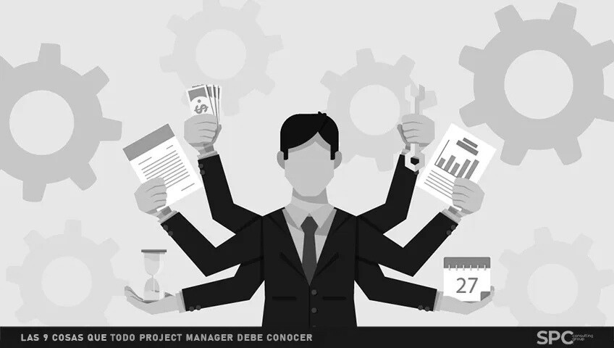

PROJECTISING LIFE: WHY IMPORTANT?
It helps personal growth and independence
01
02
Projects give direction and meaning to life
We overcome resistance to change by framing life as projects
03

Slide 14
It helps personal growth and independence
Projectising life develops our ability to plan, to take responsibility, and to manage resources. A person who organizes their life into projects learns discipline and accountability. This makes them more independent — they are not simply driven by rumours or external pressures, but by their own structured goals. PMP describes such people as independent ‘cells’ within society: active, creative, and able to act on their own initiative.”
Example: A student who plans their thesis as a project — with a research question, chapters, deadlines, and available resources — grows in independence and responsibility compared to a student who waits passively for instructions.
Projects give direction and meaning to life
Projects are more than activities. They connect daily tasks to broader goals. With a project, every step leads to an outcome; achievements can be measured and celebrated. This gives life coherence and meaning, because actions are not random but part of a bigger plan. By seeing life as projects, we transform routine into purpose.
Example: A young professional who treats career development as a project — setting milestones such as certifications, internships, and promotions — gains direction and meaning in their professional journey.

Slide 15
Overcoming resistance to change
Change often creates fear, uncertainty, or resistance. But when we frame change as a project, it becomes structured and less threatening. A project always has a start and an end, with clear steps and results. This time-bound structure allows people to accept change more easily. Resistance is reduced because change is not seen as endless chaos, but as a manageable project with milestones.
Example: A family moving to a new city may feel anxious. But if the move is planned as a project — with a timeline (packing, transport, settling), resources (budget, contacts), and goals (new school, new job) — the transition becomes smoother and less stressful.
In this way, projectising life is not simply about management; it is about shaping ourselves into proactive, independent, and purposeful individuals

Slide 16
PPPP INPUTS 2 MAIN FIGURES:
They are unique ones and give to the Project strengths and flexibility.
Determination and estimation of them is a peace ofart and lays to PM
1.Difference of Levels
2. Project Supporter

Slide 17
(CDoL) Coefficient of DoL. It is calculated by dividing the number of the people interested in the P. per 1000 population in the respective place of P. implementation (optimal scenario) or even more precisely per 1000 potential clients from the total population of the place (pessimistic scenario). The calculation can be done by both methods, depending on the available statistics.
This is a simplified calculation of the CDoL. In order to provide an easier calculation, this method of calculation will be applied in the examples that follow.
The complex calculation of the CDoL includes two elements:
- Arithmetic step of accumulation in a larger population;
∑x = {y/1000 + y/x}
Х – the number of multiples of the population up to 1,000. with a population of 10,000; x = 10;
У – the number of people interested in the project per 1000
- Qualitative indicators of accumulation in a larger population, which affect the CDoL.
∑x = {y/1000 + y/x + К}
Qualitative accumulation rate per 1000 population.
DoL=InV x CDoL. DoL. We obtain the vertical along the DoL coordinate axis for each P. Linear quantity (DoL P1, DoL P2…. DoL P6 on the graph)

Slide 19




3 PHASES OF THE PROJECT’S REALIZATION
Preparation
Execution
Finalization

Slide 20
PREPARATION PHASE OVERVIEW
The 'passport' of the project includes its name, goals, and timeline.
Defining clear tasks and expected results is essential
No project should begin without this blueprint.

Slide 21
PREPARATION PHASE OVERVIEW (PASSPORT OF THE PROJECT)
The preparation phase centers on the Project Passport — the precise description including project name, place, time, main goals and the PM. Preparation defines phases/sub-phases, key tasks, and resource allocation. It also begins the legal, institutional and social studies that will shape feasibility. Preparation finishes with the Business Plan (BP) that consolidates the legal study, economic justification, competitive analysis, SWOT/risk assessment and a three-scenario financial model (optimistic/realistic/pessimistic). This BP is the gatekeeper for execution.

Slide 22
DEFINING CLEAR TASKS AND EXPECTED RESULTS IS ESSENTIAL
In the preparation phase, the Project Manager must define every task precisely and link it to expected results. This is the only way to measure whether a project is successful or not. Without clarity in tasks and results, the execution phase will collapse into confusion. Each task should be connected to a milestone, and each milestone must be realistic and measurable. The Project Passport, as described in the material, always includes goals, tasks, and expected outcomes. These are the backbone of preparation

Slide 23
NO PROJECT SHOULD BEGIN WITHOUT THIS BLUEPRINT
The Business Plan, or BP, is the blueprint of the project. It combines the passport with legal, financial, institutional, and social analyses. It also includes economic justification, risk assessment, and financial scenarios. Without this blueprint, a project has no foundation. The lecture materials emphasize that no project should begin without a BP, because it provides the structure and legitimacy needed to attract investors, secure resources, and guide the execution. Beginning without a BP is compared to building a house without a design: the result will be unstable, unpredictable, and unsustainable

Slide 24

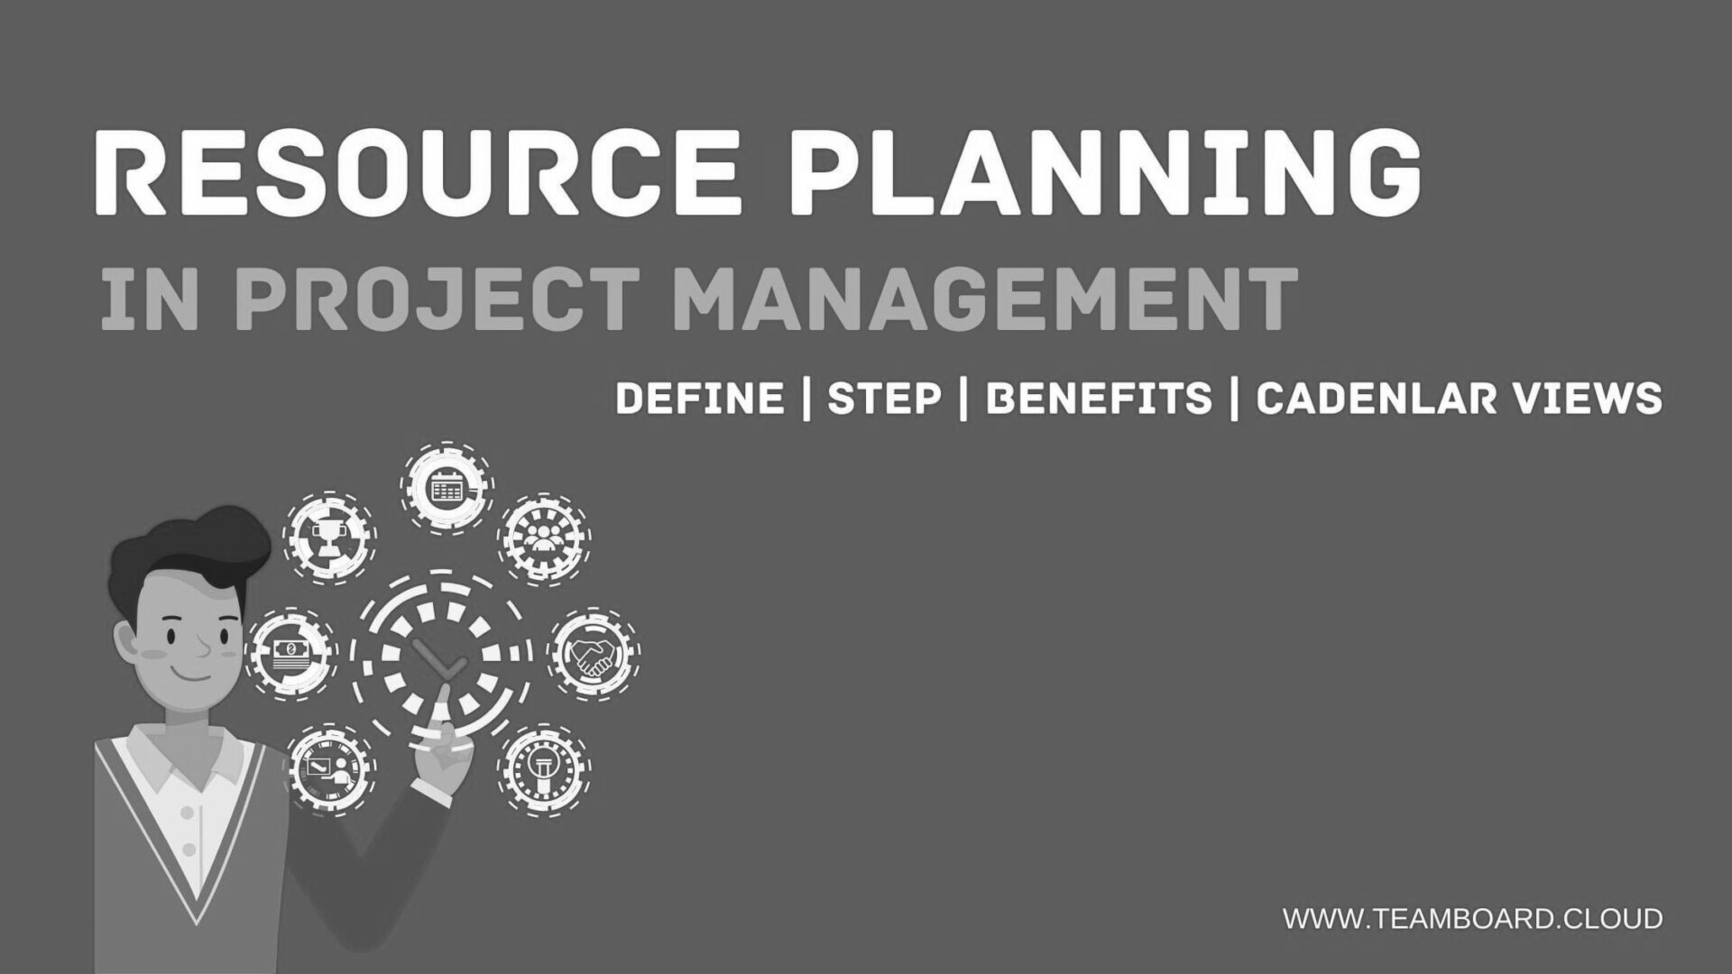
RESOURCES IN PROJECT PREPARATION
PROJECTS RELY ON FOUR KEY RESOURCES
Financial
Manpower
Legal
Institutional/Social
The PM must integrate all resources systematically

Slide 25
FINANCIAL RESOURCES
FINANCIAL RESOURCES ARE THE FIRST BARRIER AND THE FIRST ENABLER FOR ANY PROJECT. THE LECTURE MATERIALS CLASSIFY FUNDING INTO DONORS (UN AGENCIES, EU), INSTITUTIONAL DONORS (WORLD BANK, EBRD, ADB), COMMERCIAL BANKS (CREDIT LINES, REVOLVING LOANS) AND MARKET INSTRUMENTS (VENTURE CAPITAL, CROWDFUNDING).
PROJECT FINANCE MAY BE STRUCTURED AS NON-RECOURSE (RISK BORNE BY LENDER), PARTIAL RECOURSE, OR FULL RECOURSE (PM BEARS RISK). EACH OPTION HAS TRADE-OFFS: DEVELOPMENT BANKS OFTEN PROVIDE FAVORABLE TERMS AND CONSULTING, BUT ARE SELECTIVE; COMMERCIAL BANKS REQUIRE CREDITWORTHINESS; ALTERNATIVE FINANCE IS FLEXIBLE BUT MAY LACK PREDICTABILITY. THE PM MUST CHOOSE A MODEL AND ACCEPT RESPONSIBILITY FOR THE CHOSEN FINANCIAL ARCHITECTURE.

Slide 26
POSSIBLE FINANCIAL RESOURCES
Donors
Institutional donors
UN and UN organizations, a total of 26 (UNESCO, UNICEF, ILO, FAO, UNDP, UNIDO, etc.). Wide areas of social activities are financed. They work with established companies and NGOs (list), but the additional inclusion of new entities is possible;
EU. Management at national and regional level (e.g. regional hubs have been set up for third countries). It also covers a wide range of activities. It is a particularly suitable tool for social platforms, training and consulting P.
USAID. Extremely suitable for SMEs and start-ups. The focus is on career formats and administrative reforms (processes and institutions) such as P.
WB/ IMF/ IFC (although they are UN bodies, they have a mixed role, not a purely donor one). Stabilizing policies.
EBRD/ EIB. Regional type, politically oriented;
ADB/ AIIB. Regional type, hybrid oriented (policy plus imposition of influence in the region);
Subregional type: Black Sea Investment Bank, NORD BANK, etc. Intermediaries in large financial framework contracts.
The development banks in various countries: KfW, ADF, EXIMBANK and others.
The common thing here is the extremely low interest rate as well as the provision of consulting services as a bonus in the implementation of the P. In addition, there are a number of good conditions such as a grace period, bearing the interest in certain cases and more. The negative aspect of this type of financing: - they finance large and established companies; - they finance only certain businesses; - lack of flexibility in funding.

Slide 27
POSSIBLE FINANCIAL RESOURCES
Commercial banks.
Investment mechanisms
The principle of the main financial action here is LIBOR (London Interbank Offered Rate) and the credit rating of a particular country, territory or individual corporation.
Forms: - Credit line (openness and trust between the two parties); - Framework credit line (within the project, but for a specific action or acquisition); - Revolving loan (continuing loan within the project, without the need for new contractual relations).
The use of credit increases the responsibility of the PM for its repayment, respectively for the implementation of the P. The establishment of a relationship of trust with the commercial bank leads to the fact that it monitors and controls the P. during all its phases, which proves to be of certain assistance to the PM.
JV (Joint Venture). Obtaining a percentage of the P. in turn of investment. With the possibility to leave after a certain period or revaluation of the share participation following revaluation of the P. once the set time for exit is reached. JVs can be resorted to at a later stage in the development of the P, and some better terms will be agreed on at that time;

Slide 28
SHARED FINANCIAL PLATFORMS
www.kickstarter.com www.kiva.org www.crowdfunder.com www.kabbage.com www.onevest.com
Platforms between end-users
www.lendingclub.com
Horizontal Cooperative clusters:
Financial circular systems that are popular in the United States and the United Kingdom.
Innovative forms of capital accumulation only (without project financing): PayPal; FundBox, etc.
Peer-to-Peer platform (P2P). Especially popular in the US, Asia, and less in the EU. Unification of small investors and individual creditors to finance a P. at the suggestion of appraisers of the platform. An independent audit firm is often hired as appraisers. A number of formalities that exist in the above forms of funding are avoided.
Negative elements: - lack of security and longevity of funding; - relatively high interest rate (almost twice as high as commercial banks).
Mixed and configured forms.

Slide 29
HUMAN RESOURCES (MANPOWER)
Human resources include the core team, outsourced specialists, and project partners. The PM must build a team with complementary skills, ensure diversity of competencies, and deploy clustering or outsourcing for specialized tasks (IT, legal, research).
The documents stress realistic team planning: staff rotation to prevent burnout; motivating staff via clear assignments and small sanctions for counterproductive behaviour; and psychological awareness of team stress. The PM remains the only person with the holistic view required to combine technical expertise, local knowledge and managerial capacity.
Team structure example: PM / Technical Lead / Finance / Legal / Community Liaison / Outsourced IT.

Slide 30
LEGAL RESOURCES
Legal resources define the boundaries of action. Legal analysis is a BP mandatory section: it covers permits, ownership regimes, sector regulations, and national vs international legal constraints. In some fields (real estate, health), licensing and cadastre checks are essential. The materials also note that e-government and online tools can speed approvals, but reliance on technology does not replace the need for proper legal counsel. Early legal mapping reduces delays and prevents costly rework.
Example: Hospital project needs health ministry licensing, land title verification, environmental permit.

Slide 31
INSTITUTIONAL & SOCIAL RESOURCES
Institutional and social resources include relationships with government bodies, community leaders, media, NGOs and professional associations. The docs emphasize the role of traditions, religion and local psychology in permitting and acceptance. These soft factors affect permits, community buy-in, and the PS selection. Proper stakeholder mapping and engagement plans should be included in the preparation phase; failure to engage the right social groups is a common cause of project delays and conflicts.
Example: Water PPP requires early community consultations, local leader endorsements and clear communication of tariffs.

Slide 32

PROJECT SUMMARY/VISIBILITY STUDY
Method of calculating the rate of return:
Net project value
RoI = (Current Value-Original Value/Original Value) x100
ROI is usually expressed as a percentage, as it is intuitively easier to understand (as opposed to expressed as a ratio). Second, the calculation of the Return on Investment includes the net return in the numerator, as the return on investment can be either positive or negative.
When the calculations of the return on investment give a positive figure, it means that the net return is in black (because the total return exceeds the total costs). In addition, when the calculations of the return on investment give a negative figure, it means that the net return is in red, as the total costs exceed the total return. (In other words, this investment leads to a loss.) Finally, in order to calculate the return on investment with the highest degree of accuracy, the total return and total costs must be taken into account.
Cumulative (complex) formula.
The regular rate of return shows the profit or loss of an investment over a certain period of time. It is expressed as a percentage. The annual return rate, also known as the Compound Annual Growth Rate (CAGR) shows the return on investment every year. The formula for the annual rate of return is equal to the current value increasing the initial value to the final value divided by the number of years, then the whole component is subtracted from 1.
Name of the P. (including a website) with a precise description of the place and time of implementation. The P. should be presented with its duration as a whole and as separate phases/ or such developed as sub-phases of the P.
Specification of the resources identified above.
Calculation of return.

Slide 33
EXECUTION PHASE
01.
EXECUTION BEGINS WITH THE APPROVAL OF THE BUSINESS PLAN.
02.
THE PM MANAGES DAILY TASKS AND ENSURES TEAM PROGRESS
03.
TEAMS CAN BE FUNCTIONAL, PROJECT-BASED, OR MIXED

Slide 34
EXECUTION BEGINS WITH THE APPROVAL OF THE BUSINESS PLAN.
Execution, or Phase B, officially starts only after the Business Plan has been approved and the necessary resources are secured. The Business Plan is not just a formality; it is the contract that defines the goals, tasks, deadlines, and responsibilities. Without this approval, the project has no legitimacy. Once approved, the BP becomes the guiding document for every action during execution. It is the foundation against which progress will be measured.

Slide 35
THE PM MANAGES DAILY TASKS AND ENSURES TEAM PROGRESS
In execution, the Project Manager is the central figure of daily operations. The PM distributes tasks, sets schedules, and ensures that intermediate results match the targets defined in the plan. This requires constant monitoring and adjustment, because unexpected challenges always arise in practice. The PM must also keep the team motivated, solve conflicts, and rotate staff when necessary. In short, the PM is both manager and leader, balancing discipline with flexibility to guarantee continuous progress

Slide 36
TEAMS CAN BE FUNCTIONAL, PROJECT-BASED, OR MIXED
The organization of teams during execution can take three main forms. A functional team is organized by professional roles — for example, finance, legal, and technical experts each working within their domain.
A project-based team is organized around sub-projects or specific deliverables, with each group responsible for a particular output. A mixed team combines both structures, creating flexibility by using functional expertise while also assigning staff to project units.
The lecture materials suggest that functional structures are often the most effective, because they allow flexible allocation of staff across multiple projects. But in practice, the PM chooses the model that best fits the project’s needs

Slide 37
Example functional team: Finance officer handles all budgeting, legal expert manages contracts, technical engineer leads design.
Example project-based team: One group builds infrastructure, another develops training program, another manages community engagement.
Mixed team: Core functional departments exist, but some staff are temporarily seconded into sub-projects.

Slide 38
PM AS A LEADER
The PM makes decisions and motivates the team
Rotation prevents burnout and keeps creativity high.
A good PM guides but also allows initiative

Slide 39
PM AS A LEADER
The PM is the project’s leading actor: making decisions, motivating staff, rotating people as needed, and monitoring performance. Leadership in the documents is practical not ideological.
PMs should promote moderate initiative but maintain accountability; apply sanctions if necessary to contain counterproductive behaviour; and help team members move to roles where they are more effective. PM reputation and presentation are also part of the execution strategy: the PM’s public positioning helps secure support, attract partners and reduce friction

Slide 40
PM AS A LEADER
The Project Manager is more than an administrator; he or she is a leader. Leadership means making daily decisions, but also motivating the team, solving conflicts, and giving people responsibility.
The PM must balance authority with flexibility: sanctioning errors, when necessary, but also supporting initiative. The documents remind us that a PM should rotate staff according to performance, not only rank, and must help every member find their best place in the project. A good leader builds a team that functions as one body, capable of achieving extraordinary results

Slide 41

DYNAMIC (D) & STATIC (S) ELEMENTS
Static (S) = infrastructure, legal, and policy framework
Dynamic (D) = human factor and relationships
Both are necessary for project success

Slide 42
DYNAMIC (D) & STATIC (S) ELEMENTS
In every project we find two categories of factors: Dynamic and Static. Dynamic elements are the human factors the leadership, the relationships, the Project Supporter, and the team itself. Static elements are the environment infrastructure, laws, financial systems, and institutions. A project cannot succeed without a balance between these two. Too much reliance on dynamic elements creates instability. Too much reliance on static elements creates rigidity. The Project Manager must know how to combine them in the right proportion for efficiency and sustainability

Slide 43
DYNAMIC (D) & STATIC (S) ELEMENTS
Dynamic factors (D) are human and relational: leadership, team psychology, networking.
Static factors (S) are physical and structural: infrastructure, legal frameworks, financial tools. The lecture stresses that both are essential and must be modeled: D often changes quickly and is less predictable; S is slower but can create systemic constraints.
The PM must assess where the project sits on the D/S scale and plan interventions accordingly: invest in capacity building if D is weak, or in policy work if S is the bottleneck

Slide 44
BALANCING D & S
Too much S = rigid bureaucracy and slow progress.
Too much D = unstable reliance on people
Balance creates efficiency and innovation

Slide 45
BALANCING D & S
The text identifies four combinations and their strategic implications:
(1) Unknown D & Unknown S — highest uncertainty; PM must perform deep reconnaissance and small pilot fragments.
(2) Known D / Unknown S — the team is proven but infrastructure/regulation is new; focus on infrastructure mapping and contingency.
(3) Unknown D / Known S — the environment is stable but the team must be assembled and social capital built.
(4) Known D & Known S — the lowest risk environment; innovate on product/service rather than structure. Each combination requires a distinct sequencing of tasks and risk mitigation in the BP

Slide 46
BALANCING D & S
Each situation requires different strategies. The Project Manager must adapt to these conditions and choose the right path for success.
Example matrix showing typical sectors:
New market entry = Unknown/Unknown;
urban upgrades = Known S but Unknown D.

Slide 47

TYPES OF D/S COMBINATIONS
Known D / Unknown S: trusted team, new infrastructure
Known D & S: easiest but still requires creativity
Unknown D & S: most difficult situation
Unknown D / Known S: new team, familiar environment
01

Slide 48
TYPES OF D/S COMBINATIONS
Unknown D and Unknown S the most difficult situation, where the team and the environment are both unfamiliar.
Unknown D with Known S, where the environment is clear but the human resources are uncertain.
Known D with Unknown S, when we trust our team but face new conditions.
Known D and Known S, the safest combination, but one that can limit innovation.
Each situation requires different strategies. The Project Manager must adapt to these conditions and choose the right path for success
01

Slide 49
BUILDING NETWORKS & CONTACTS
Study history of similar projects in the target area
Build trust with institutions, businesses, and media.
Early promotion of the PM and project is essential
01

Slide 50
BUILDING NETWORKS & CONTACTS
Projects do not operate in isolation. Building networks is one of the most important tasks of a Project Manager. Before starting, the PM must study the history of similar projects, understand what worked and what failed, and learn about the social groups involved. Once the project begins, the PM must position themselves among institutions, businesses, professionals, communities, and the media. Promotion of both the Project Manager and the project itself is essential. Without networks and strong contacts, projects risk failure. With them, projects gain legitimacy and strength
01

Slide 51
ESTABLISHING THE PROJECT SUPPORTER (PS)
SELECTING THE RIGHT PS IS CRITICAL FOR SUCCESS
RELATIONSHIPS GROW THROUGH STAGES: CONTACT, TRUST, COOPERATION
PS ACTS AS A BRIDGE BETWEEN PM AND SOCIETY
01

Slide 52
ESTABLISHING THE PROJECT SUPPORTER (PS)
Phase (1) is the confidential phase of building the contact tree: professional contacts (institutions, companies) and personal contacts (family, local dignitaries). The PM should compile CVs and short psychological portraits of PS candidates. The materials emphasise selecting one primary PS to avoid divided loyalties, while keeping backups in reserve. The PS should be evaluated for competence, reputation and ability to open doors. A successful PS reduces friction in permits, hiring and community acceptance

Slide 53
ESTABLISHING THE PROJECT SUPPORTER (PS)
A Project Supporter is more than just an assistant; it is a trusted ally. The PS helps the PM at every stage, from preparation to finalisation. A good PS must be competent, but also trustworthy. In many development projects, NGOs or community leaders serve as Project Supporters, because they bring local knowledge and credibility. Choosing a PS is one of the most strategic decisions a Project Manager can make. The documents advise us: choose one main PS carefully, and prepare alternatives if necessary. The relationship with the PS is built on trust, professionalism, and mutual respect.

Slide 54
CRITICAL MOMENTS IN PROJECT MANAGEMENT
CHALLENGES INCLUDE LACK OF RESOURCES, CONFLICTS, AND STRESS
THE PM MUST STAY RESILIENT AND ADAPTABLE
STRONG LEADERSHIP IS CRUCIAL DURING CRISES
01

Slide 55
CRITICAL MOMENTS IN PROJECT MANAGEMENT
CRITICAL MOMENTS ARISE FROM RESOURCE SHORTFALLS, TEAM CONFLICTS, OR PSYCHOLOGICAL PRESSURE. THE PM MUST MAINTAIN COMMUNICATION CHANNELS, SUPPLY CLEAR DIRECTIVES AND INTERVENE EARLY IN CONFLICTS. THE DOCUMENTS ADVISE STRUCTURED INTERNAL MEETINGS, MODERATED ESCALATION PROCEDURES AND PSYCHOLOGICAL SUPPORT WHERE NECESSARY. REGULAR ROTATION PREVENTS FATIGUE; TRANSPARENT CRITERIA FOR REWARDS AND SANCTIONS MAINTAIN FAIRNESS AND DISCIPLINE. THE PM’S STEADINESS IS OFTEN THE SINGLE MOST IMPORTANT FACTOR IN NAVIGATING CRISES.

Slide 56
CRITICAL MOMENTS IN PROJECT MANAGEMENT
EVERY PROJECT FACES CRITICAL MOMENTS. THESE INCLUDE SHORTAGES OF RESOURCES, CONFLICTS WITHIN THE TEAM, OR PSYCHOLOGICAL STRESS ON THE PROJECT MANAGER. COMMUNICATION PROBLEMS CAN ALSO BE CRITICAL. RESEARCH SHOWS THAT MORE THAN 11% OF INVESTMENT WORLDWIDE IS WASTED BECAUSE OF POOR PROJECT PERFORMANCE. A GOOD PM MUST ANTICIPATE THESE MOMENTS, PREPARE SOLUTIONS, AND REMAIN CALM UNDER PRESSURE. THE ABILITY TO MANAGE CRISIS SITUATIONS IS ONE OF THE HALLMARKS OF A STRONG PROJECT MANAGER

Slide 57
SUSPENSION OR TERMINATION
PROJECTS MAY STOP DUE TO INVESTOR OR PM WITHDRAWAL
FORCE MAJEURE (NATURAL OR POLITICAL CRISES) MAY ALSO END PROJECTS
SOMETIMES CREATIVE SOLUTIONS CAN SAVE THEM
01

Slide 58
SUSPENSION / TERMINATION / MERGING & SEPARATION
PROJECTS MAY BE SUSPENDED OR TERMINATED FOR INVESTOR WITHDRAWAL, PM RESIGNATION, OR FORCE MAJEURE. BEFORE TERMINATING, THE PM SHOULD EXPLORE SALVAGE OPTIONS (RESTRUCTURING, NEW INVESTORS, SCALING DOWN). THE DOCUMENTS ALSO COVER MERGING OR SPLITTING PROJECTS — STRATEGIC DECISIONS THAT AFFECT GOVERNANCE AND MAY REQUIRE A NEW BP. THE PM MUST EVALUATE ECONOMIC RETURNS, LEGAL OBLIGATIONS AND SOCIAL COSTS BEFORE RECOMMENDING SUSPENSION OR TERMINATION. TRANSPARENT COMMUNICATION WITH INVESTORS AND STAKEHOLDERS IS MANDATORY

Slide 59
SUSPENSION / TERMINATION / MERGING & SEPARATION
DECISION TREE:
PROBLEM IDENTIFIED → ATTEMPT RESCUE (YES/NO) → RESTRUCTURE/MERGE → TERMINATE.
Sometimes projects cannot continue. Suspension or termination may happen when investors withdraw, when the PM leaves, or in the case of force majeure, such as natural disasters or political crisis. For example, many infrastructure projects have been stopped because of disputes over land acquisition. But the Project Manager must remember: suspension is not always the end. Sometimes creative solutions allow the project to restart. The decision to stop or continue must always be made with responsibility and transparency

Slide 60
DISSEMINATION OF THE PROJECT
A successful project continues even without the PM.
It operates under market rules and principles.
The PM may return only in cases of crisis.

Slide 61
FINALISATION, DISSEMINATION & CONTROL
Finalisation means the project reaches operational stability and can operate without day-to-day PM control. Dissemination is the process whereby project outputs are shared or institutionalized (e.g., a service integrated into public provision).
Post-finish control can be ongoing by in-house staff, periodic investor monitoring, or programmatic audits. Guarantees or warranties — contractual service assurances — are frequently required to secure investor and public trust. Finalisation thus includes both handing over and setting up long-term oversight.

Slide 62
FINALISATION, DISSEMINATION & CONTROL
The goal of every project is finalisation. A project is finalised when it can continue to function without daily involvement of the Project Manager, operating under market rules or institutional mechanisms. Dissemination means that the results of the project spread and become useful to society.
For example, a startup project that grows into a self-sustaining company, or a social program that continues to serve communities after donor support ends. Finalisation and dissemination are proof that the project has produced lasting impact.

Slide 63




CONTROL & GUARANTEES
Projects require continuous monitoring and audits
Investors may demand guarantees or post-project services.
Guarantees add credibility and support future projects

Slide 64
CONTROL & GUARANTEES
Even after finalisation, projects require control and guarantees. Investors may demand ongoing monitoring, governments may require periodic reports, and users may expect warranties. Guarantees can be contractual, such as service guarantees in a PPP hospital, or voluntary, as a sign of professional conviction. Guarantees increase credibility and trust, not only for the current project but also for future ones. They are part of the long-term reputation of the Project Manager

Slide 65

SPECIFICS OF IT PROJECTS
Types: online, hybrid, and offline projects
Virtual reality is a new environment for project execution
PMs must adapt to new communication and resources

Slide 66
SPECIFICS OF IT PROJECTS
IT projects differ because many deliverables can be digital, replicable and tested at low cost. The ITP passport usually starts with an alpha or demo version; funding sources include business angels, VCs, accelerators and P2P platforms.
ITPs operate in both Real (R) and Virtual (VR) environments — some elements cannot be virtualized (touch, taste) and that limits transformation in certain sectors (e.g., hospitality). The PM of an IT project needs either technical competence or an intermediate programmer to translate needs into specifications; co-location of the core team is recommended for rapid integration and to reduce communication overhead.

Slide 67
SPECIFICS OF IT PROJECTS
Information Technology projects have their own specifics. They can be online, hybrid, or offline. They often exist in both the real world and in virtual reality. Some elements can be transmitted easily through the internet like documents, images, or sound. Others, like touch, taste, or smell, cannot. This creates unique opportunities and limitations.
For example, in education, IT projects can create virtual classrooms. The passport of an IT project often begins with an alpha version or a demo, rather than a full plan. Financing can also come from modern sources such as venture capital, accelerators, or crowdfunding

Slide 68

ROLE OF AI IN PROJECTS
AI supports projects at all stages: analysis, automation, monitoring.
AI cannot replace PM’s creativity and judgment.
Final decisions must always remain human-led.

Slide 69
ROLE OF AI IN PROJECTS
Information Technology projects have their own specifics. They can be online, hybrid, or offline. They often exist in both the real world and in virtual reality. Some elements can be transmitted easily through the internet like documents, images, or sound. Others, like touch, taste, or smell, cannot. This creates unique opportunities and limitations. For example, in education, IT projects can create virtual classrooms. The passport of an IT project often begins with an alpha version or a demo, rather than a full plan. Financing can also come from modern sources such as venture capital, accelerators, or crowdfunding

Slide 70



BENEFITS & CHALLENGES OF IT PROJECTS
IT projects are faster, cheaper, and less risky
Challenges include sustainability and data security
Best practice: combine strengths of real and virtual worlds

Slide 71
Role of AI & Benefits/Challenges of IT Projects
AI can support analysis, automation and monitoring across project phases — from predictive risk models to routine report generation. Yet the materials stress that AI cannot replace human creativity, judgment and responsibility; final decisions remain with the PM. Benefits of IT projects include faster prototyping, modular scaling and lower cost of testing.
Challenges highlighted include sustainability, cybersecurity, occasional market bubbles and fraud risks in novel financial instruments. The recommended approach is hybrid: use AI to augment human decision-making, keep human oversight and design safeguards for security and ethics.

Slide 72
AI IN PROJECT MANAGEMENT
Artificial Intelligence is now transforming project management. AI can analyze data, monitor progress, automate tasks, and predict risks. It can replace some elements of both dynamic and static resources.
But the documents remind us: the final decision always remains with the Project Manager. Human judgment, creativity, and social responsibility cannot be replaced by machines. According to studies, AI can reduce project costs and speed up processes. But it must be integrated carefully, as a tool that supports, not replaces, human leadership

Slide 73
PPP Global Data & Case study bridge
Public–Private Partnerships (PPPs) combine public legitimacy and private efficiency to finance and operate infrastructure or services. The lecture materials (and PPP Knowledge Lab reference you provided) show that transport, energy and water are key sectors. PPPs require careful allocation of risks, clear contracts and detailed BP analysis.
The Jakarta MRT example (as a PPP) demonstrates how layered financing, strong PS (government), and experienced PMs can deliver major urban benefits like decongestion and better mobility. PPPs therefore require a specialty in aligning public policy, private incentives and social acceptance.

Slide 74
PPP GLOBAL DATA
Public–Private Partnerships, or PPPs, are now a global reality. They are used to build roads, railways, energy plants, and water systems. According to PPP Knowledge Lab, about 40% of PPP projects are in transport, 30% in energy, 15% in water and sanitation, and 15% in other sectors.
Since 1990, more than 5,000 PPP projects have been launched in over 130 countries. PPPs are powerful because they combine public legitimacy with private efficiency. They show how cooperation between government and business can deliver real benefits to society

Slide 75
Closing
End the lecture with an action assignment to apply PMP to a personal goal. Students should prepare a one-page Project Passport: name, objective, PM (self), time frame, required resources (financial, HR, legal, institutional), one potential Project Supporter, and one pilot fragment.
The passport makes abstract goals concrete; filling it provides immediate experience of the preparation phase and helps students to test assumptions before risking resources.
Encourage students to use the BP outline for projects that require external resources

